Slide 1
Introduction to SAP Technical ERP Modules

Slide 2
SAP BASIS (Business Application Software Integrated Solution)
SAP BASIS stands for Business Application Software Integrated Solution. It is a set of tools that will work as a bridge between your operating system, communication protocols, the various business applications, and database. SAP BASIS also includes different administration activities.

Slide 3
The different functionalities of the SAP BASIS software are mentioned below
1
2
3
4
Configuration and installation of SAP applications and systems
Determining bugs, errors and tweaking the SAP systems for maximum performance
Overseeing that the different users of the SAP systems have the correct authorization rights. They must be able to use the functions they need
5
Executing and maintaining the background jobs
Restoring the essential data and keeping backups

Slide 4
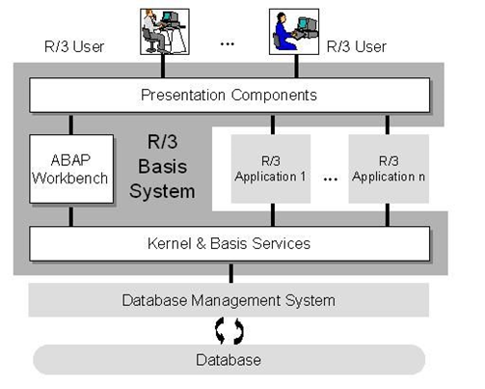
The layers of the SAP BASIS system are:
Presentation layer
Application layer
Database layer

Slide 5
Basis Administration
BASIS administration refers to all the different activities performed by an administrator. The aim is to keep the SAP environment stable.
BASIS administration is also important for the following:
Maintenance
System Tasks
Planning & Scheduling

Slide 6
SAP Basis consultant's responsibilities
A SAP BASIS consultant runs a SAP landscape. He or she must have a strong technical background. Knowledge in subjects such as UNIX, LINUX, Windows, MySQL, Oracle and Java is desirable.
The different roles and responsibilities of a SAP BASIS consultant are as follows:
Monitoring servers, background jobs scheduling and job deletions
Monitoring system tasks and performance
Installation, configuration and maintenance of SAP systems
Database operations such as backup, schedule, maintenance and restoration
Handling and maintaining SAP licenses

Slide 7
Requirements for SAP BASIS
The primary objective or requirement of SAP BASIS is to keep the SAP systems running smoothly, securely and to ensure their stability. Both production and non-production environments are covered by Requirements for SAP BASIS.
Performance analysis, installation of patches, upgrades and modifying parameters are all covered.
Requirements also focus on troubleshooting and monitoring the systems regularly.

Slide 8
For all these day-to-day activities, a dedicated SAP Basis team is required.
Here are some reasons why such a team will be beneficial for any business
Cost & Time Efficiency
Dealing with Complex Problem Easily
Meeting Customer Requirements
SAP Basis and Upgrades

Slide 9
SAP BASIS vs. SAP HANA
SAP Basis is used for holding the SAP landscape and system together. SAP HANA is a relational database management system used developed by SAP. Administration of SAP Hana will require a specific skill set. This can be acquired from SAP Basis administration.

Slide 10
SAP Security
SAP security is a technical module that works within SAP systems to allow access where it’s needed and prevent access where it’s not.
Establishing good internal security and access processes is a vital part of helping ensure your SAP system is protected and will function well.

Slide 11
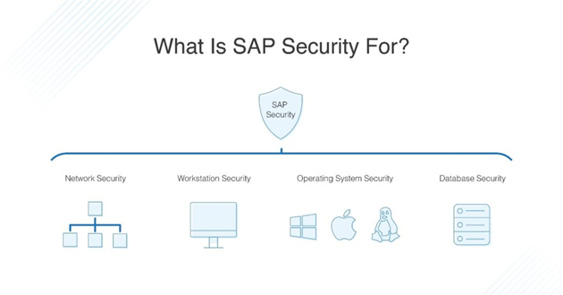

Slide 12
Once the SAP system is set up, SAP security is there to help ensure that the system works as intended, without any problems with security or data access.. There are three areas that SAP security deals with:
Confidentiality
Integrity
Availability

Slide 13
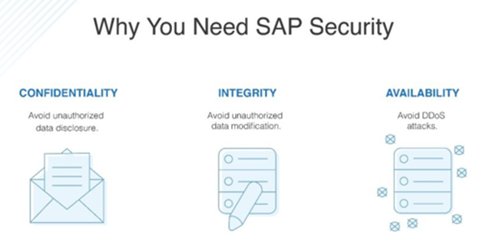

Slide 14
User Id’s and user management tools
Secure Network Communication
SAP Logon Tickets
X.509 Client Certificates
Authentication Mechanism in SAP System
Authentication mechanism defines the way you access your SAP system. There are various authentication methods that are provided:

Slide 15
SAP HANA (High Performance Analytic
Appliance)
SAP HANA is a combination of HANA Database, Data Modeling, HANA Administration and Data Provisioning in one single suite. In SAP HANA, HANA stands for High-Performance Analytic Appliance

Slide 16
SAP HANA is a combination of software and hardware innovation to process huge amounts of real time data
Based on multi core architecture in distributed system environment
Used extensively in Memory Computing Engine (IMCE) to process and analyze massive amounts of real time data
Based on row and column type of data-storage in database
Features of SAP HANA

Slide 17
Need for SAP HANA
HANA overcomes the limitations mentioned below
Due to unavailability of real time data, analysis and processing results are delayed
Due to the increase in “Data Volume”, it is a challenge for the companies to provide access to real time data for analysis and business use.
It involves high maintenance costs for IT companies to store and maintain large data volumes.

Slide 18
IBM
Dell
HP
Cisco
Fujitsu
SAP HANA Vendors

Slide 19
In-Memory Computing Engine
An In-Memory database means all the data from the source system is stored in a RAM memory. In a conventional Database system, all data is stored in hard disk. SAP HANA In-Memory Database wastes no time in loading the data from hard disk to RAM.
Features of In-Memory Database
1
2
It combines row based, column based and Object-Oriented base technology
3
4
Conventional Database reads memory data in 5 milliseconds. SAP HANA In-Memory database reads data in 5 nanoseconds
SAP HANA is Hybrid In-memory database
It uses parallel processing with multicore CPU Architecture.

Slide 20
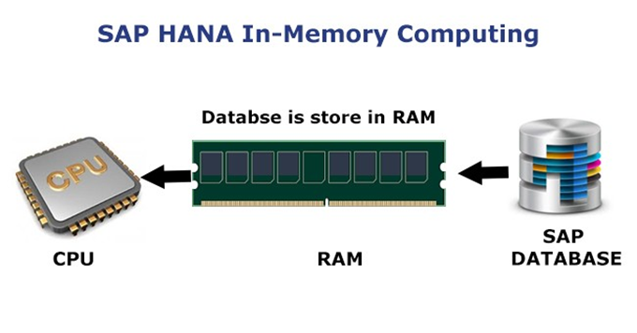

Slide 21
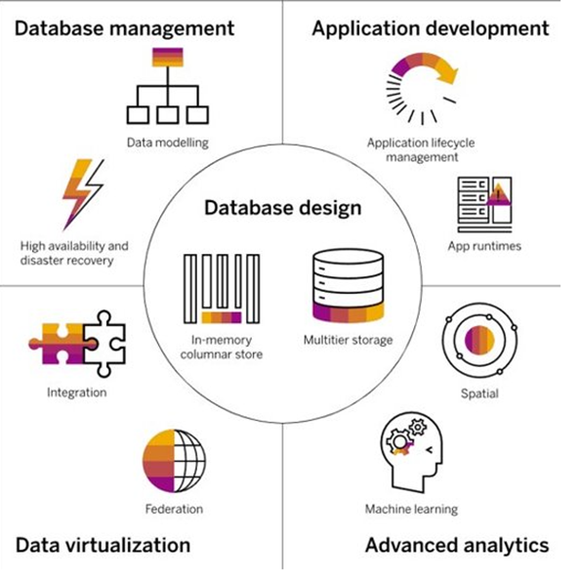
HANA Architecture
SAP HANA’s in-memory, column-oriented architecture is built for fast queries and high-speed transactions
https://www.sap.com/india/products/hana.html

Slide 22
Studio & Administrative View
SAP HANA studio is an Eclipse-based tool. SAP HANA studio is both the central development environment and the main administration tool for HANA system. Additional features are
It is a client tool, which can be used to access local or remote HANA systems.
It provides an environment for HANA Administration, HANA Information Modeling and Data Provisioning in HANA database.

Slide 23
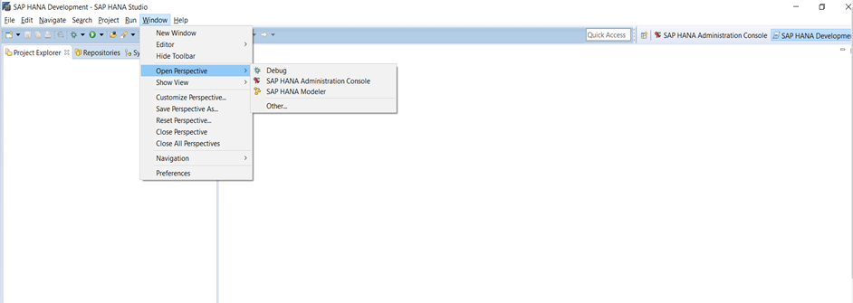
SAP HANA Studio Perspectives / Features
SAP HANA Studio provides perspectives to work on the following HANA features. You can choose Perspective in HANA Studio from the following option
HANA Studio
Window
Open Perspective
Other

Slide 24
SAP HANA Studio Application Development
By default, all features are installed.
Administrator Editor can be accessed in several ways
From System View Toolbar
Choose Open Administration default button
In System View
Double Click on HANA System or Open Perspective

Slide 25
1
2
3
4
Port 3615 should be open to connect to Database
Port 31015 Instance No 10
Port 30015 Instance No 00
SSh port should also be opened
Adding a HANA System to Studio
To add new HANA system, host name, instance number and database user-name and password is required.

Slide 26
Catalog and Content
Catalog
It contains all available Schemas i.e., all data structures, tables and data, Column views, Procedures that can be used in Content tab.
Content
The Content tab contains a design time repository, which holds all information of data models created with the HANA Modeler. These models are organized in Packages. The content node provides different views on the same physical data.

Slide 27
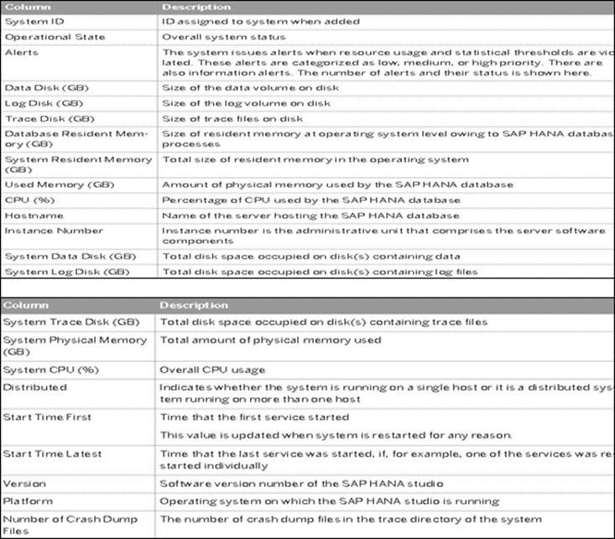
System Monitor
System Monitor in HANA studio provides an overview of all your HANA system briefly.

Slide 28
Information Modeler
SAP HANA Information Modeler; also known as HANA Data Modeler is heart of HANA System.
Features of Information Modeler
Provides multiple views of transactional data stored in physical tables of HANA database for analysis and business logic purpose.
Informational modeler only works for column-based storage tables.
SAP HANA Modeling Views exploit the real power of SAP HANA.

Slide 29
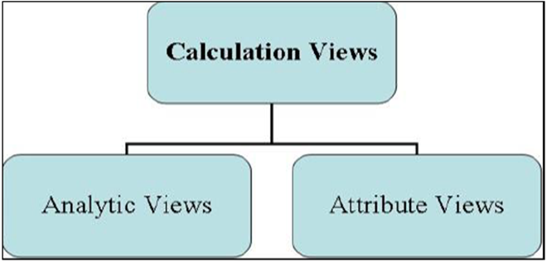
Information Modeling Views
Attribute View
Attributes are non-measurable elements in a database table. They represent master data and are like characteristics of BW.

Slide 30
Analytic View
Calculation Views are used on top of Analytic and Attribute views to perform complex calculations, which are not possible with Analytic Views. Calculation view is a combination of base column tables, Attribute views and Analytic views to provide business logic
Analytic Views use the power of SAP HANA to perform calculations and aggregation functions on the tables in database. It has at least one fact table that has measures and primary keys of dimension tables and surrounded by dimension tables contain master data.
Calculation View

Slide 31
Difference between SAP HANA, S/4 HANA & C/4 HANA
SAP HANA
SAP HANA is an in-memory database technology which acts as the core technology for a lot of other SAP or non-SAP applications whereas SAP S/4 HANA is a new generation ERP solution which runs on SAP HANA database architecture.
SAP S/4 HANA
SAP C/4HANA is a customer experience (CX) suite designed to change customer relationship management (CRM) as we currently know it. SAP C/4HANA is a “Next-generation CRM” because this solution modernized the legacy CRM solutions.
S/4 HANA is a business suite launched as a robust ERP solution having both ERP and BI capabilities utilizing HANA’s in-memory computing power. It is an in-memory version of the ERP Business Suite as it only runs on SAP HANA.
SAP C/4 HANA

Slide 32
SAP CRM (Customer Relationship Management)
SAP CRM is the CRM tool provided by SAP and is used for many a business process
SAP CRM is a part of SAP business suite. It can implement customized business processes, integrate to other SAP and non-SAP systems, help achieve CRM strategies.

Slide 33
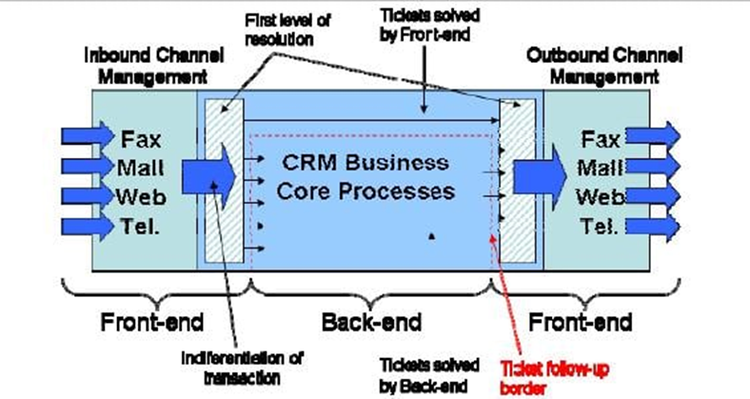
SAP CRM Work-Flow

Slide 34
Features of SAP CRM
It is a part of SAP Business Suite to manage customer relationship.
It supports all customer-focused business areas such as marketing, sales and service.

Slide 35
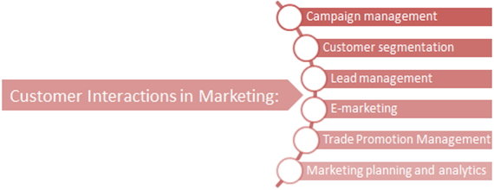
SAP CRM Marketing

Slide 36
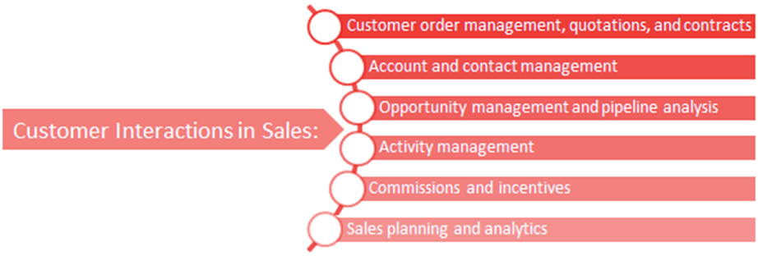
SAP CRM Sales

Slide 37
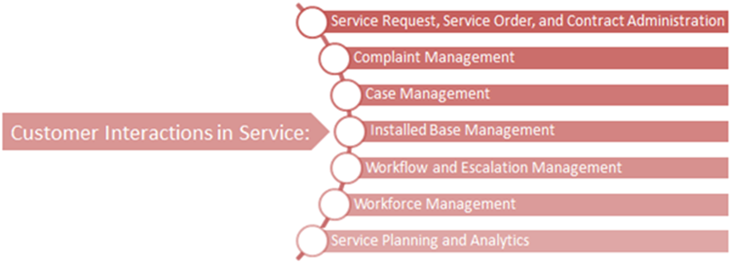
SAP CRM Service

Slide 38
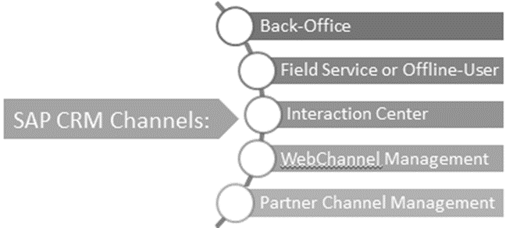
SAP CRM Channels

Slide 39
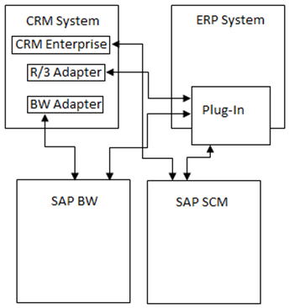
Overview of SAP CRM Architecture

Slide 40
SAP ABAP (Advanced Business Application
Programming)
ABAP (Advanced Business Application Programming) is the name of SAP’s proprietary, fourth-generation programming language. It was specifically developed to allow the mass-processing of data in SAP business applications.

Slide 41
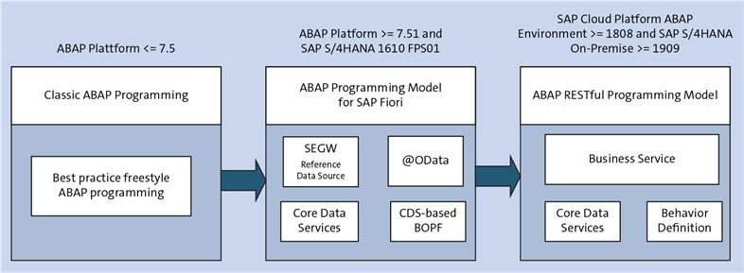
A Brief History of ABAP
ABAP was first introduced by SAP in the 1980s. Throughout the years, various enhancements to the language increased what programmers could do with it.
In May 2000, SAP changed ABAP with release 4.6C, allowing for object-oriented programming (OOP).

Slide 42
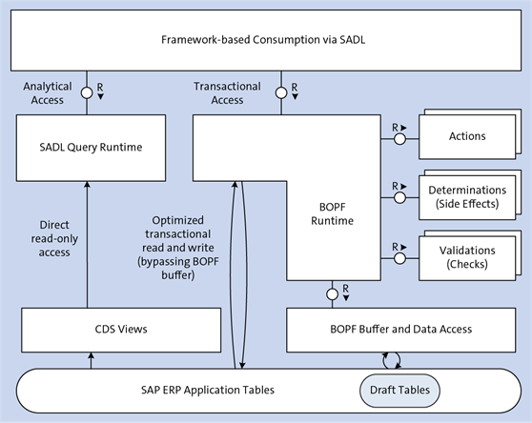
The first, the ABAP programming model for SAP Fiori, is used when developing SAP HANA-optimized OData services for SAP Fiori applications.

Slide 43
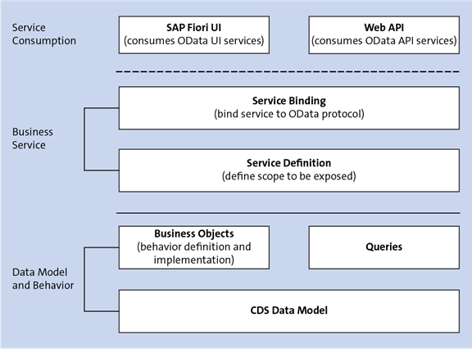
The ABAP RESTful programming model is a very new paradigm based on the model for SAP S/4HANA, but eschews Business Object Processing Framework (BOPF) in place of a more advanced concept.

Slide 44
SAP BW (Business Warehouse)
SAP Business Intelligence (BI) means analyzing and reporting of data from different heterogeneous data sources. SAP Business Warehouse (BW) integrates data from different sources, transforms and consolidates the data, does data cleansing, and storing of data as well. It also includes data modeling, administration and staging area.

Slide 45
The BI platform provides infrastructure and functions which include −
Process designer and other functions
OLAP Processor
Metadata Repository

Slide 46
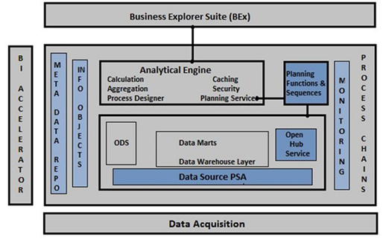
The following diagram shows an open, broad and standard based Architecture of Business Intelligence
Reference: https://www.tutorialspoint.com/sap_bw/sap_bw_overview_of_sap_bi.htm

Slide 47
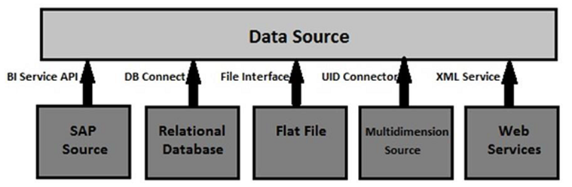
Data Acquisition in SAP BI
SAP BI allows you to acquire data from multiple data sources that can be distributed to different BI systems.
Reference: https://www.tutorialspoint.com/sap_bw/sap_bw_overview_of_sap_bi.htm

Slide 48
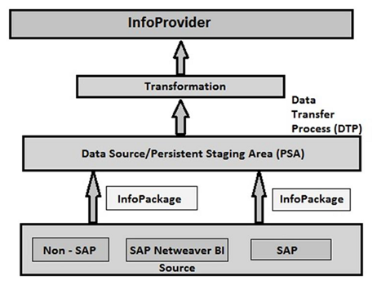
BI Data Flow (InfoPackage and InfoProvider)

Slide 49
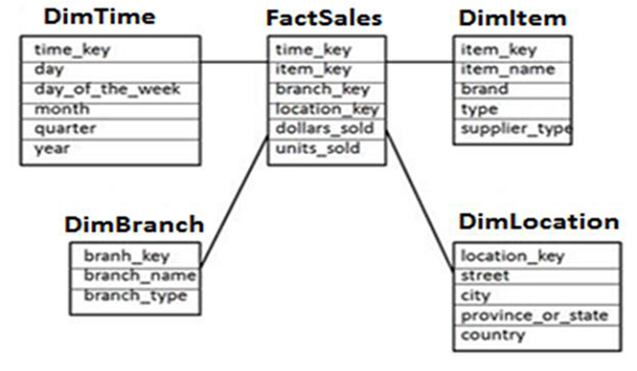
Data Warehousing
Star Schema
In Star Schema, each dimension is joined to one single fact table. Each dimension is represented by only one dimension and it is not further normalized.
Reference: https://www.tutorialspoint.com/sap_bw/sap_bw_data_warehousing.htm

Slide 50
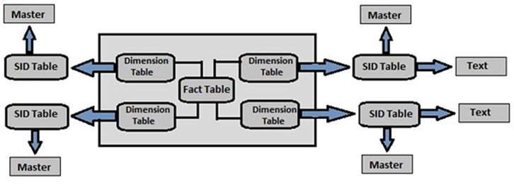
Extended Star Schema
In Extended Star schema, fact tables are connected to dimension tables and this dimension table is further connected to SID table and this SID table is connected to master data tables.
Reference: https://www.tutorialspoint.com/sap_bw/sap_bw_data_warehousing.htm

Slide 51
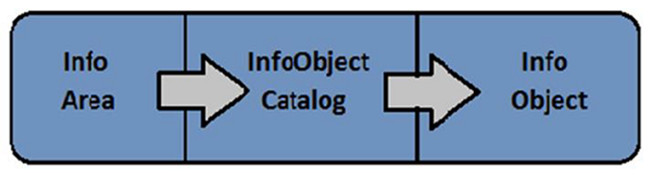
InfoArea - Info Area in SAP BI is used to group similar types of objects together.
InfoObjects - InfoObjects are known as the smallest unit in SAP BI and are used in Info Providers, DSO’s, Multi providers, etc. Each Info Provider contains multiple InfoObjects.
Reference: https://www.tutorialspoint.com/sap_bw/sap_bw_data_warehousing.htm

Slide 52
References
https://blogs.sap.com/2008/05/09/sap-project-system-a-ready-reference-part-1
https://training.sap.com/content/sap-training-hana
https://learning.sap-press.com/abap
https://data-flair.training/blogs/sap-hana-vs-sap-s-4-hana/
https://axxis-consulting.com/what-is-sap-c4hana/

